Slide 1
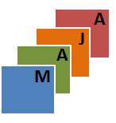
MAJA Software
Introduction and feedback on the development of OTB applications
Pierre Lassalle

Slide 2
Plan
Introduction of the software MAJA
MAJA refactoring

Slide 3
Introduction of the software MAJA

Slide 4
What is MAJA ?
MACCS-ATCOR joint algorithms
MACCS for Multi-mission Atmospheric and Cloud Detection Software
The first big project using OTB !
Generation of level 2A product :
Atmospheric correction
Cloud detection
Estimation of the AOT (Aerosol Optical Thickness)

Slide 5
Operational for several satellites
Formosat-2
LANDSAT 5, 7 and 8
SPOT4 and SPOT 5
Sentinel-2A, Sentinel-2B
Venus soon.

Slide 6
Cloud detection
Combination of several detection methods:
Threshold on the Cirrus band for LANDSAT 8 and Sentinel-2
Multi-temporal test on the reflectance variation of the blue band: a steep increase reveals a cloud pixel.
Finally, the potential cloudy pixel is cloudy if its neighborhood does not correlate well with the same neighborhood in the previous images acquired at different dates.

Slide 7
Cloud detection

Slide 8
AOT Estimation
Several criteria are used in a cost function:
A multi-temporal criterion based on the fact that corrected pixels from successive observations have nearly the same reflectance values.
A multi-spectral criterion: $r_{blue}=2 ∗r_{\left\{red\right\}}$
Dark pixel method

Slide 9
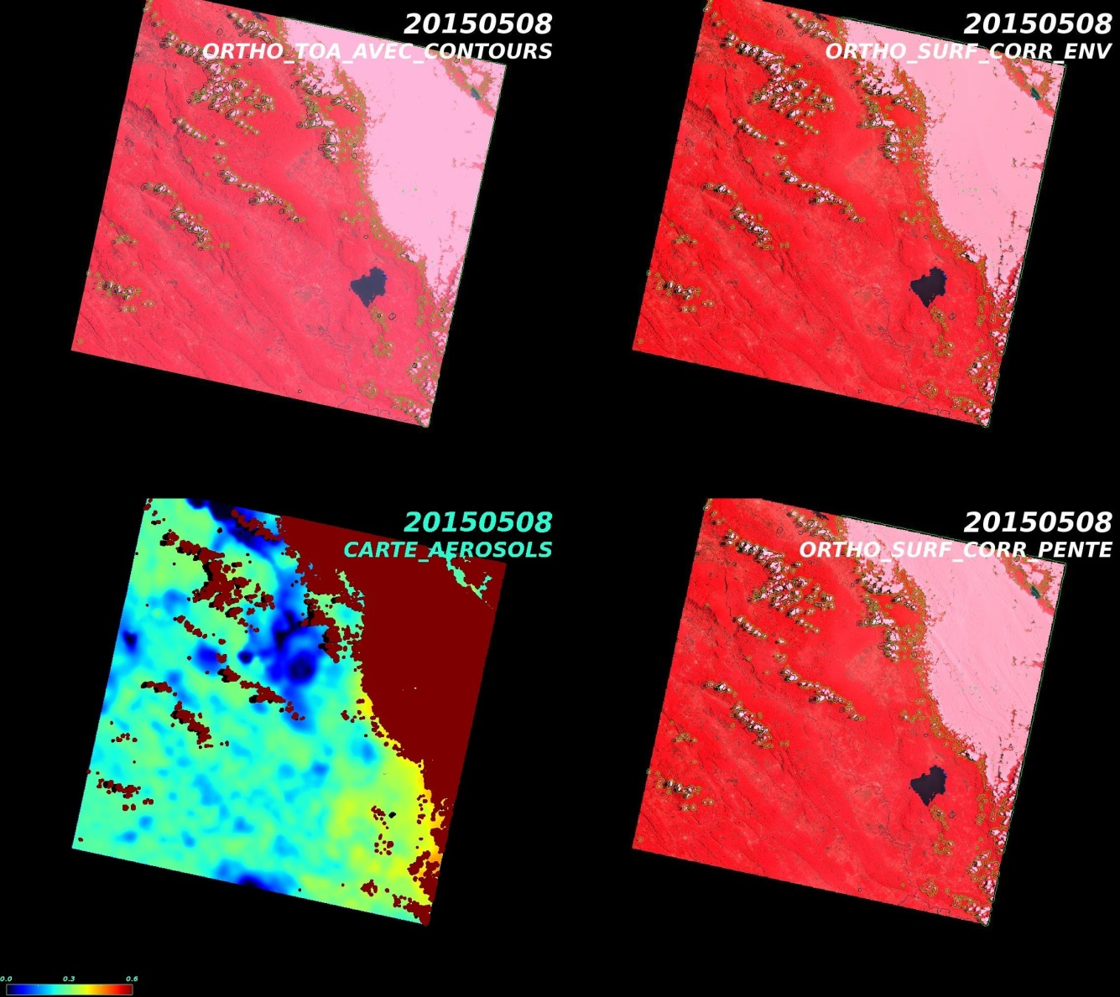
AOT Estimation

Slide 10
Atmospheric correction
Compute the corrected surface reflectance from AOT and using the SOS radiative transfer code.
Update the composite image (most recent free-cloud pixel) which will be used for the next image in the time series.

Slide 12
MAJA binaries available
Maja binaries can be downloaded here:
https://logiciels.cnes.fr/fr/license/57/144
An interesting tutorial with good resources can be found here:
https://github.com/olivierhagolle/Start_maja

Slide 13
MAJA refactoring

Slide 14
Motivations
MAACS/MAJA is based on OTB and was developed at the time where there were no OTB applications
At the beginning, it has been designed for 2 sensors (Venus, Formosat-2) and it has been gradually adapted to handle more sensors (LANDSAT, SENTINEL-2)
Need of independent otb applications to be used in another contexts:
An app for the cloud detection
An app for the atmospheric correction
Simplify the atmospheric correction to apply on Pleiades products

Slide 15
Goals (1/2)
Decomposition of the L2 processing chain into independent OTB applications:
Atmospheric Absorption
Cloud detection
AOT estimation
Water masking
Snow Masking
…
Chain the OTB applications to recreate the L2 processing chain

Slide 16
Goals (2/2)
The chaining has to be fast and efficient:
Data preparation done with Python scripts
Application chaining done with Python scripts
In-memory connection:
import otbApplication as otb
app1 = otb.Registry.CreateApplication("Smoothing")
app2 = otb.Registry.CreateApplication("Smoothing")
app1.IN = argv[1] app1.Execute()
# Connection between app1.out and app2.in app2.SetParameterInputImage("in",app1.GetParameterOutputImage("out"))
app2.ExecuteAndWriteOutput()

Slide 17
Difficulties
Complex dependencies between applications:
Images have to stay a long time in memory ☹
A lot of parameters for each application
Outputs of some key applications are used as inputs of several successive applications:
For each in-memory connection between 2 applications, the entire process to generate the inputs is executed again ☹

Slide 18
Possible solutions
In-memory connection:
Generate the intermediate images once and keep them in memory as numpy array
Itk::ImageFileWriter synchronization ?
Synchronization point: intermediate images are written to the disk
Parameters handling:
Use of 2 xml parameter files:
One for fixed set parameters (values do not change often): concern a lot of parameters actually
One for dynamic parameters: kind of short

Slide 19
Work in progress…
Thank you !

