Slide 1
Benchmarking of image processing libraries for the Euclid science ground segment
By Peter Kettig
Supervisor: Antoine Basset, CNES

Slide 2
Outline
Introduction to the Euclid project
Outline of the mission
The science ground segment
Benchmark of image processing libraries
Necessity
Connection to OTB
Structure
Contenders
Preliminary results
Conclusion & Prospect
Image Source: Euclid Consortium
Notes:
Right: Preliminary design of telescope by TAS
show what I do within the framework of this project
results: just started, not finished yet

Slide 3
1.1 The Euclid Project - Outline
Euclid:
ESA’s new space telescope, to be launched in 2020
Collaboration of 14 EU countries + Canada & USA
Main Objectives:
Understanding why the expansion of the Universe is accelerating
What is the nature of the source responsible for this acceleration
Main Payload: 1.2m telescope with VIS and NISP instruments
Mission goal: Observe weak gravitational lensing over 15.000 $deg^{2}$
Image Source: Euclid Consortium
Notes:
// Payload by ADS, Sat.-Bus by TAS
// Not too much info about physical background - not a physicist - But I can still try
// NISP = Near infrared spectrometer and photometer
// Quite different from typical OTB applications
// The image: The sky covered by the euclid mission in ecliptical coordinates - Middle: Our solar system the U-shaped ark: Our galaxy

Slide 4
1.2 The science ground segment
The SGS: Developing the data processing chain:
Raw images → Processed Images → Catalogues → Cosmological parameters
Will take care of approx. 175PB of data
Distribution of processing into multiple data centres across the member states
CNES contributing to the development, with algorithms mainly developed by laboratories
Processing is split into smaller elements, each responsible for one specific task
E.g.: detecting and masking of cosmic rays
Notes:
Red: That's where I am working
SGSs also executing this chain
Distribution because amount of data so big
Example algorithm:
- LACosmics - Cosmics detection with laplacian edge detection
- Used as example algorithm for implementation

Slide 5
2.1 Benchmark of image processing libraries
Necessity for this benchmark:
The SGS needs a common library for the image processing part
→ Needs to be efficient, versatile and comprehensive, with active support and extensive documentation
Creation of own library too costly and time consuming
Connection to OTB:
For OTB, both ITK and OpenCV are necessary – Also the case for Euclid?
Performance of both libraries also determines big part of OTB’s performance
→ How ”good” are the contenders compared to others?
Notes:
There is no "best" library to begin with -> that's why benchmark
For OTB:
// Mostly not time critical, like here..
// But maybe resource limited? -> Benchmark will give insight

Slide 6
2.2 Structure of the benchmark
Each library is tested in different categories, which can be divided into two classes:
Dynamic
Memory usage
Computation time
Static:
Completeness of functions
Amount of documentation available
Licensing
Number of lines needed for implementation
Implementation of multiple algorithms (e.g. Cosmics detection) to test them!
Notes:
Most think of dyn. criteria first
...But static are also important!
Multiple ways to implement a given algorithm
-> Watch complexity and level of abstraction
-> Only limited Optimisation

Slide 7
2.3 Contenders
So far, the long list of libraries contains 17 libraries
4 of them were selected for the short list and the test implementations:
OpenCV
ITK
Cimg
Boost GIL
Each library has a different design approach/ideology – comparison can be difficult
Multiple benchmarks: dependency on image size, profiling of memory/CPU usage
Notes:
On top of design approach:

Slide 8
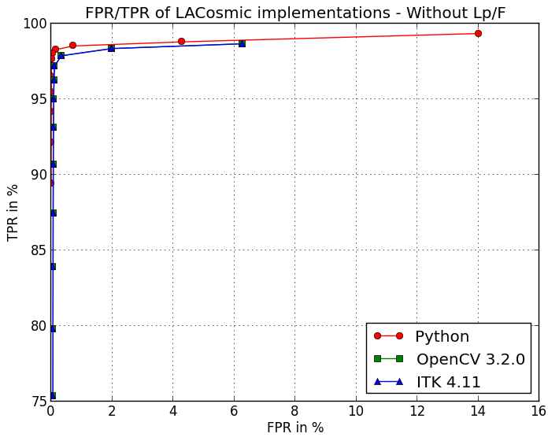
3. Preliminary Results
Validation of both algorithms:
FPR and TPR rate of simulated cosmics (and their respective model)
Red curve: Original implementation – differs from paper, therefore just used for validation and not as a template
Blue/Green: Implementations in OCV and ITK - identical

Slide 9
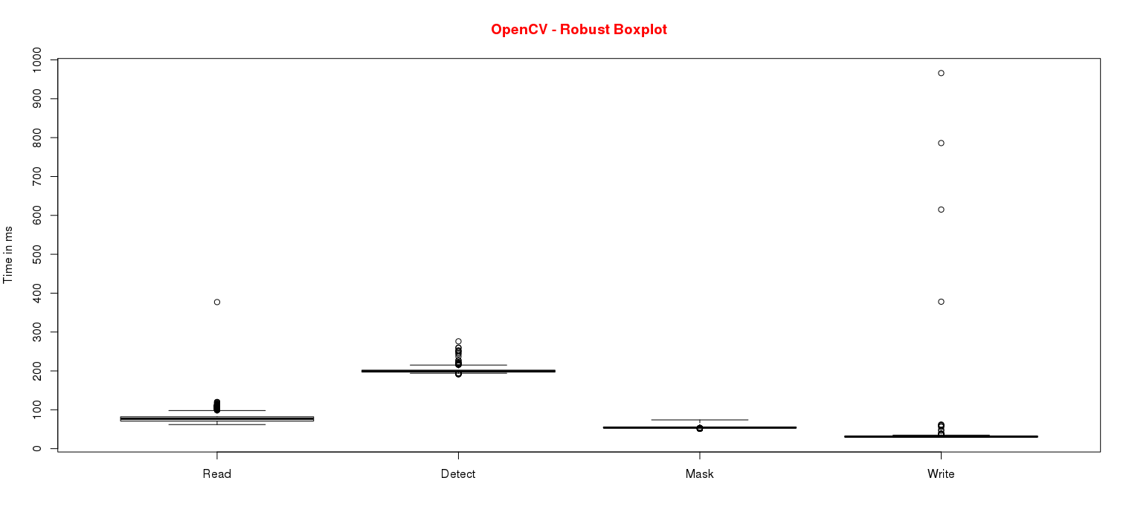
3. Preliminary Results
Missing Documentation can be a problem (e.g. BoostGIL)
Some libraries incomplete and therefore not suitable for the project
First results with Opencv – time variation of 144 runs in a boxplot:

Slide 10
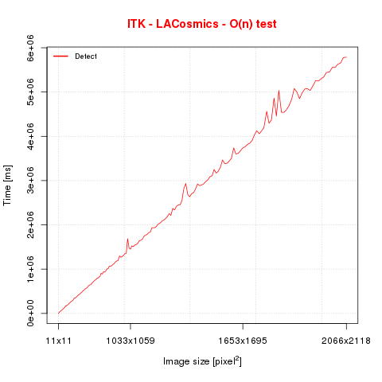
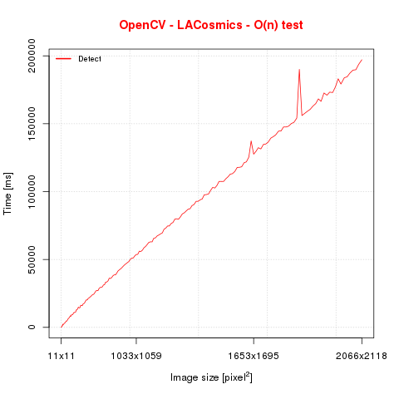
3. Preliminary Results
Missing functions can be a problem
Some libraries incomplete and therefore not suitable for the project (e.g. BoostGIL)
First results with Opencv and ITK – Dependency on input image size:
Notes:
(OpenCV Median 7x7 with floating point)
Results: Similar shape, but Y-Axis completely different scale! ...OpenCV better?! Read it in the paper!

Slide 11
Conclusion & Prospect
Not all implementations finished yet
Dynamic performance tests will be conducted later at the CNES HPC in Toulouse
Results about performance of each library within August
…and if you’re curious: Paper will be written under the supervision of university and CNES which will summarize the results
Project can be extended:
Benchmark is project specific – contenders as well
Many more libraries that can be considered

Slide 12
Thank you!
Any Questions?
Or even better: ideas?

